Slide 1

Hospital Appointment System(HS) with Linear Searching Algorithm
Presented By:
Ashish KHADKA

Slide 2
Introduction
A desktop application to make an appointment to cure disease.
User-Friendly Interface for making appointment scheduling a quick and straightforward process.
Real-time Availability- availability of doctors and enabling to choose suitable time slots.

Slide 3
Objective
Record information related to diagnosis given to patients.
To provide searching facility to choose the familiar doctors as possible.
Enhance user experience by enabling patients to check in digitally upon arrival

Slide 4
Problem Statement
Unmanaged Patient Logging and Tracking system due to which there may be loss of life.
Error prone Appointment System.
Unmanaged hospital Tracking system

Slide 5
Scope
Efficient management for admin
Allow for the selection of specific doctors, specialists, or medical services.
Provide flexibility in appointment time slots to accommodate varying patient needs and preferences.

Slide 6
Limitation
Lacks user feedback mechanism
System downtime due to internet issues could disrupt appointment scheduling and management

Slide 7
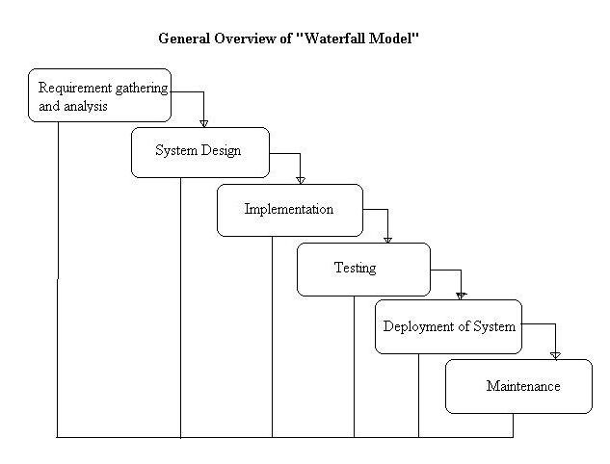
Development Methodology

Slide 8
Functional Requirements
User login
Search doctor
Create appointments between doctors
View record of their treatment
Approval of doctor
Record the details of patients and doctor

Slide 9
Non-functional Requirements
Security
Reliability
Performance
Maintainability
Scalability
Usability

Slide 10
Project Modules
Admin module – Departments of hospitals
User Module (Patient) – Appointment , Prescription details, medication, doctor list , operation history ,create appointment.
Doctor Module – Manage patient, Manage appointment with patient. Create prescription ,provide medication for patients.

Slide 11
Feasibility Study
Economic Feasibility
Development of this application is highly economically feasible.
Free software: Free Intellij IDEA and JAVA technologies are used for development.
Technical Feasibility
The application will not require huge amount of resource and high-end servers.
No sophisticated technical manpower for operation is required.
Operational Feasibility
This project aligned seamlessly with existing appointments processes and workflows.

Slide 12
Gantt Chart
Week Stage | 1 | 2 | 4 | 6 | 8 | 10 | 12
Requirement Analysis
System Designing
Development
Testing
Maintenance
Documentation

Slide 13
Tools Used
Tool | Purpose
JAVA | Frontend Development
JVM | Java Runtime Environment
JAVA | Backend Development
MYSQL, XAMPP | Database
Intellij IDEA | Coding and Development
Figma | Wireframe and UI
Github | Version Control

Slide 14
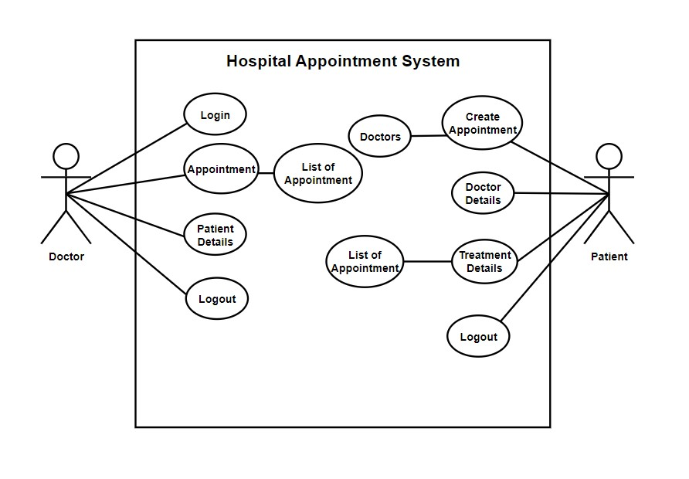
Use Case Diagram

Slide 15
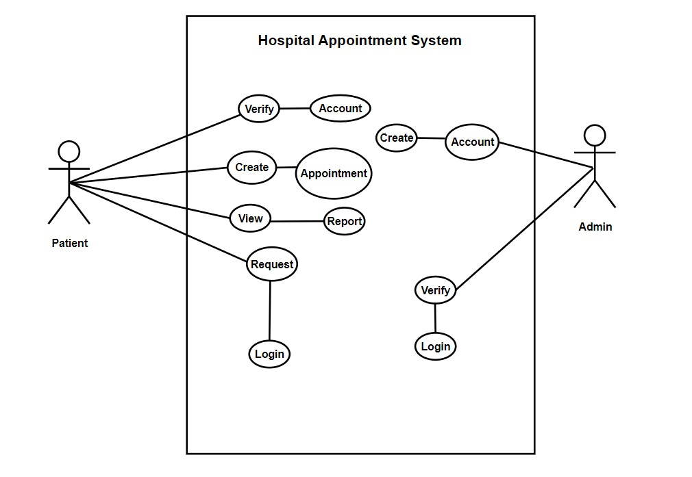
Use Case Diagram

Slide 16
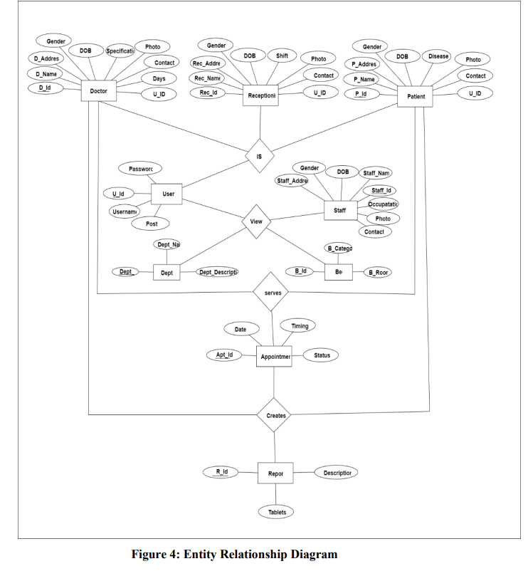
ER Diagram

Slide 17
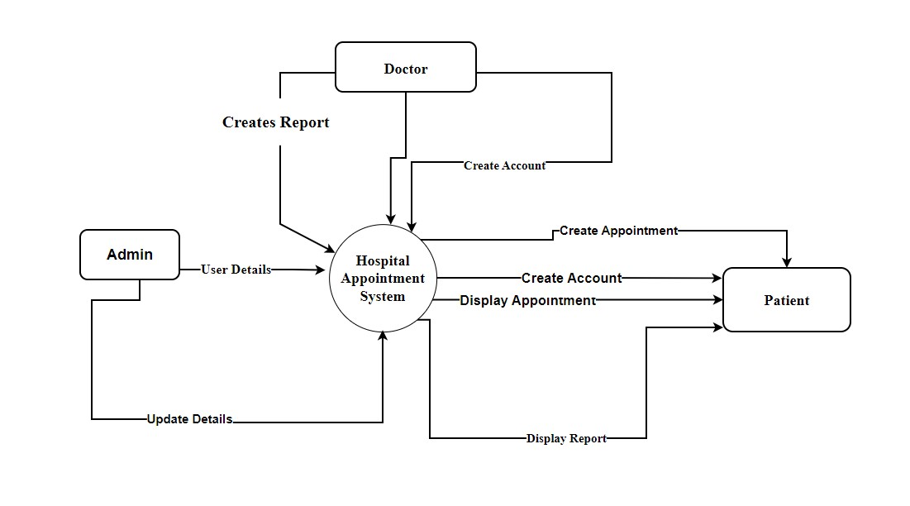
Data Flow Diagram

Slide 18
Future Recommendation
Track the blood bank and availability of blood
Billing system
Machine learning algorithm to predict some disease

Slide 19
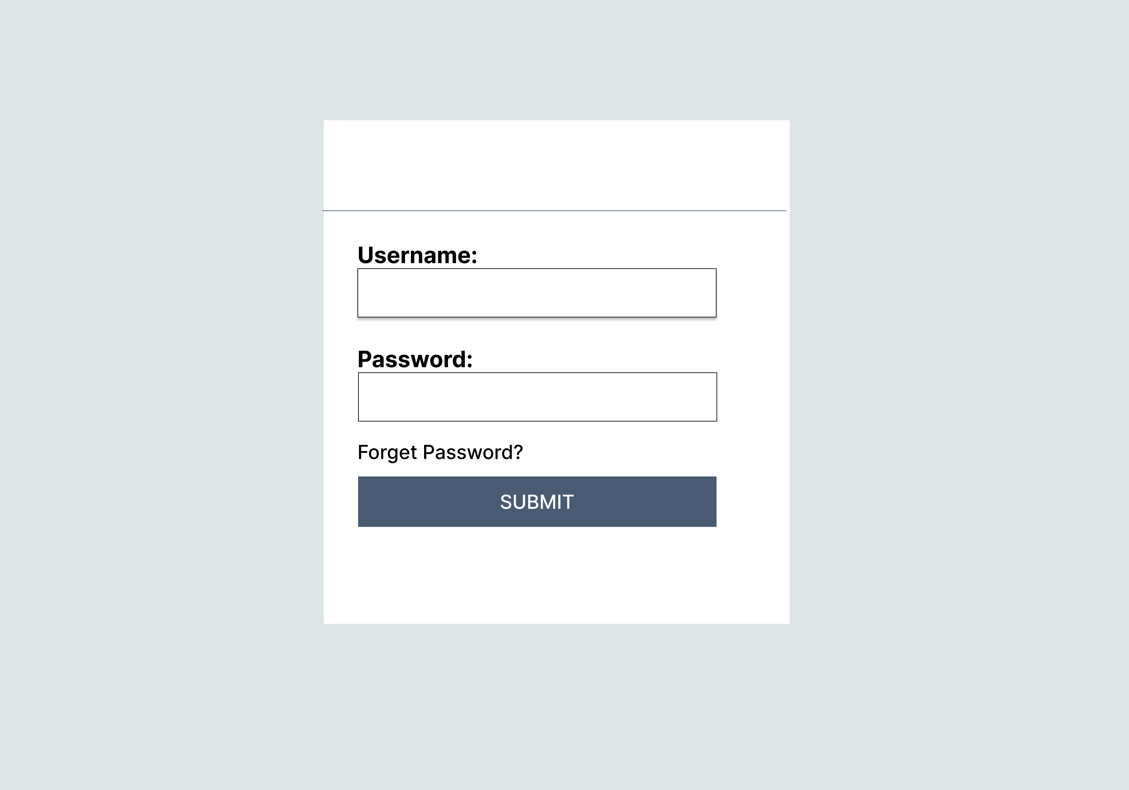
Interface Design
Login-page Wireframe

Slide 20
Interface Design
Admin- Doctor Details Wireframe

Slide 21
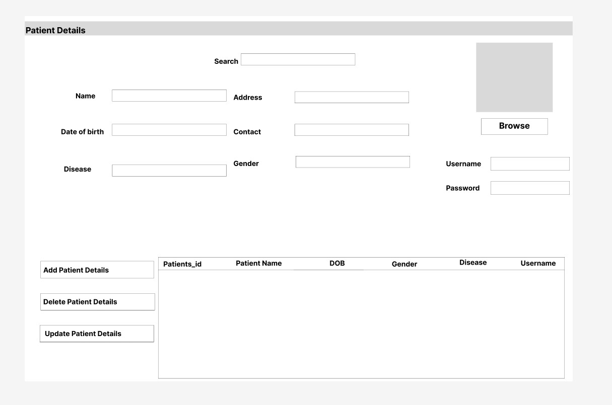
Interface Design
Admin-Patient Details Wireframe

Slide 22
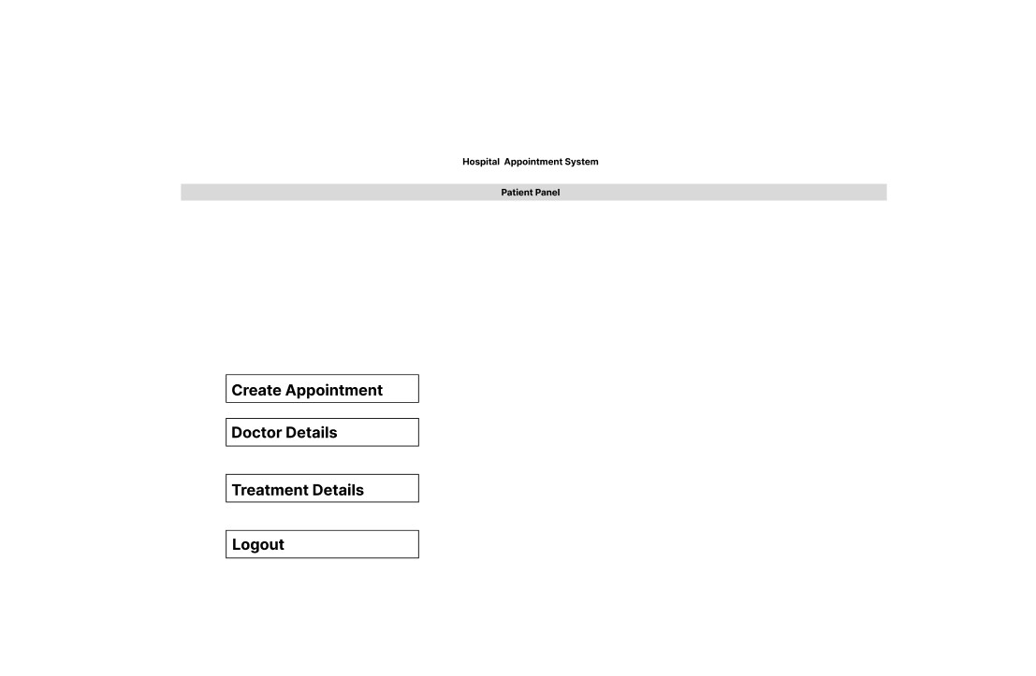
Interface Design
Patient Panel Wireframe

Slide 23
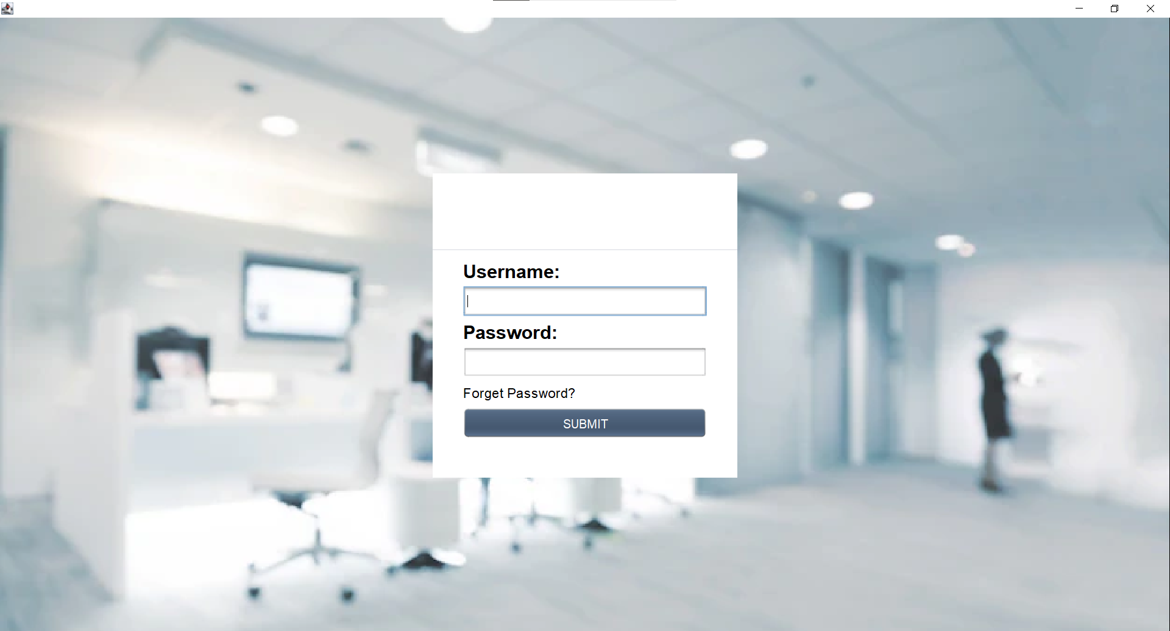
Result
Login-Page

Slide 24
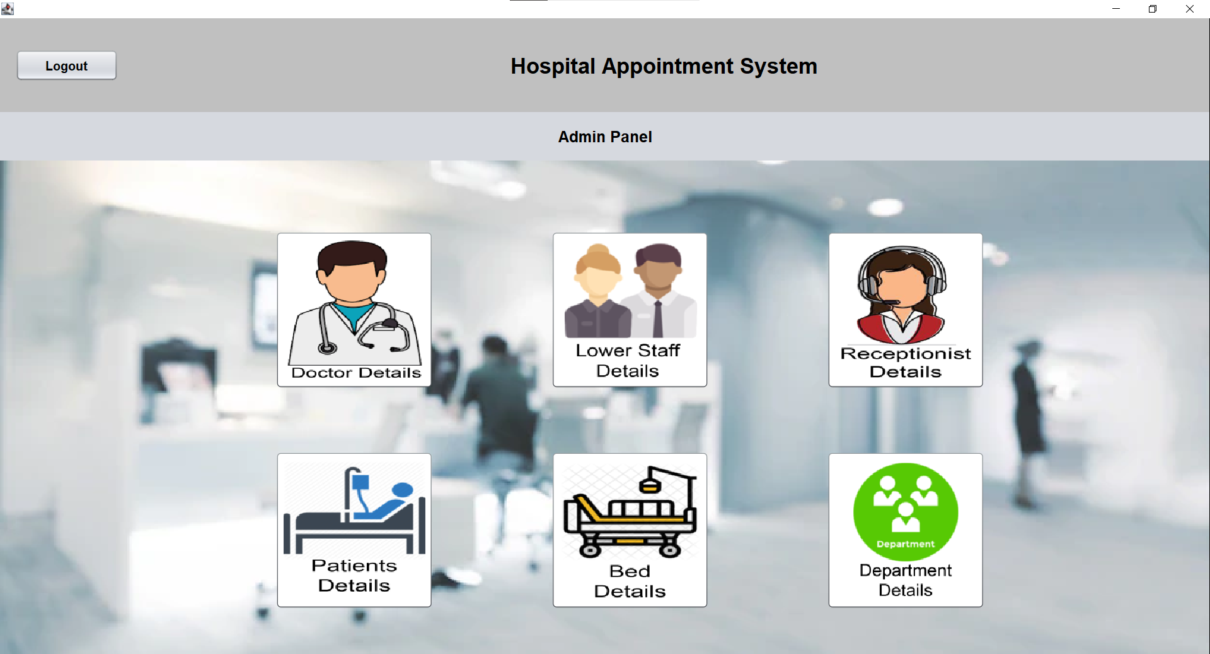
Result
Admin Panel

Slide 25
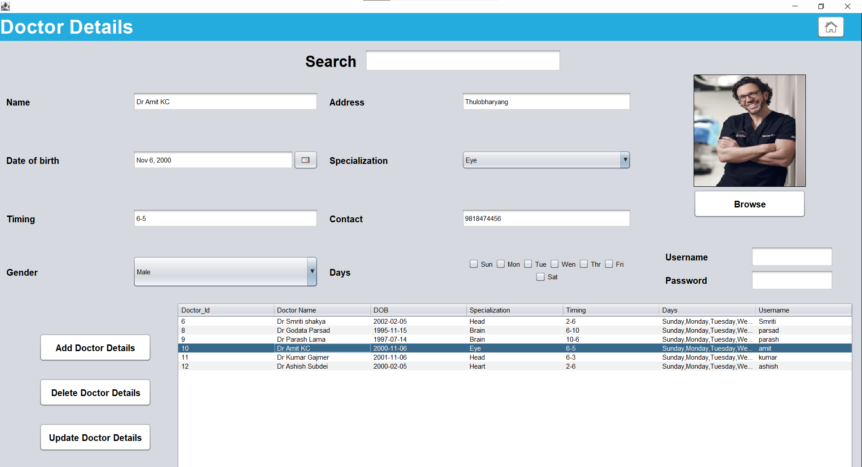
Result
Doctor Details

Slide 26
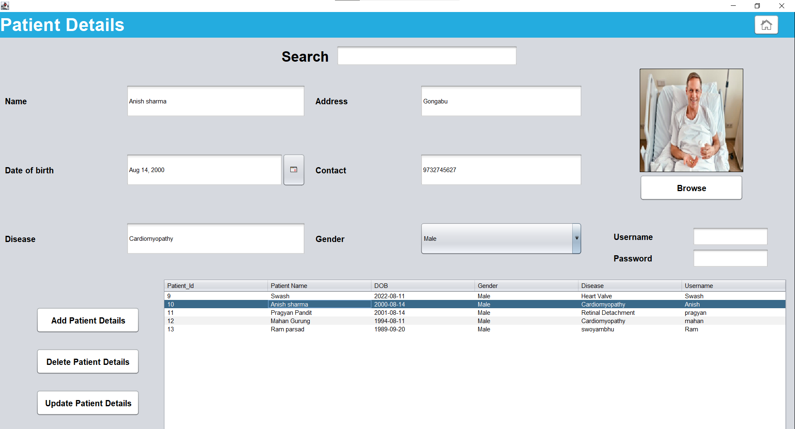
Result
Patient Details

Slide 27
THANK YOU!

